Slide 1
Reduction of commute time
Lean Six Sigma Project by Vlad Huz
Dec 16th, 2014

Slide 2
Define phase
Problem statement: Commute takes longer time then anticipated and leads to consumption of more gas; stress factor is important for consideration as well. Stable commute time is preferred to lessen stress.
Goal: Reduction of average commute time by 10%, reduction of standard deviation by 50%.
Metrics: time (sec); standard deviation.

Slide 3
SIPOC
Suppliers
Process
Customers
Output
Input
Suppliers | Input | Process | Output | Customers
Me | Cars (traffic) | Walking to the car (parking lot) | Time of commute | Me
Police | Route | Check up | Overall cost of commute | Two bosses (at home and at work)
Other drivers | Gas | Warm Up/ Defrost | Stress level
 | My car | Driving | Traffic violations
 | Weather | Parking
 | Temperature | Walking to work place from parking lot
 | Day of week, time
 | Events

Slide 4
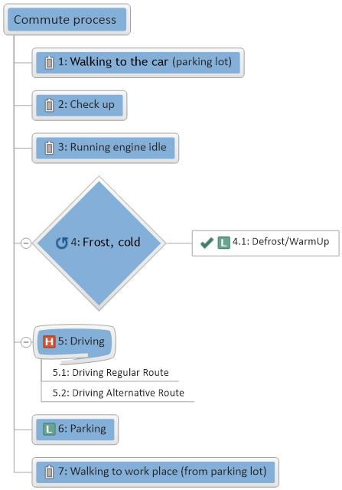
Process Map

Slide 6
Defining process step

Slide 7
MSA
In order to check if measuring system was acceptable for Design Of Experiment (DOE) the following test was performed:
Drove a specific distance in parking lot 15 times at constant speed of 5 miles per hour. The same watch was utilized for MSA and DOE. Output value is time in seconds.
Based on Statistical Analysis of the data, it was concluded that distribution is normal (P > 0.05) and StDev is approximately 2, which is acceptable.
Therefore measuring system seems acceptable for DOE.

Slide 8
Redefining the goal
After reviewing the possible root causes of long commute time, it is clear that most of time is spent during the “driving” process step.
Therefore improvement efforts are going to be concentrated in improving “driving” step, goal is redefined to reduction of driving time by 5 % and reduction of standard deviation by 50% during the driving.
Reasons for long commute under category “Methods” are subjects for review and improvement.

Slide 9
Design of Experiment (DOE)
Based on analysis of Fishbone diagram, 3 factors were chosen to explore for DOE.
Total of runs = 2^{n}, where n is number of factors and 2 represent number of levels.
Run | Day of Week | Route | Direction | Y (time)
1 | - | - | -
2 | + | - | -
3 | - | + | -
4 | + | + | -
5 | - | - | +
6 | + | - | +
7 | - | + | +
8 | + | + | +
run | Day Of Week | Route | Direction | Y
1 | NotFriday | Usual | Home-Work
2 | Friday | Usual | Home-Work
3 | NotFriday | Alternative | Home-Work
4 | Friday | Alternative | Home-Work
5 | NotFriday | Usual | Work-Home
6 | Friday | Usual | Work-Home
7 | NotFriday | Alternative | Work-Home
8 | Friday | Alternative | Work-Home

Slide 12
Recommendations pertaining improving of the process
Analysis of DOE showed that all three main factors are important and play significant role in commute time. Among three of the factors “Direction” is the most important.
Analysis of interaction plots shows that the most important are “Direction*Route” and “Direction*DayOfWeek”
Based on analysis of the commute data during Design of Experiment, it is recommended to use “Alternative” route instead of “Usual” route.

Slide 13
Control chart Friday’s data (Before and after Improvement)

Slide 19
Conclusions
Measurement of commute time after process change and comparing results concludes that overall goal was achieved.
Value | Before Improvement | After Improvement | % of improvement
StDev | 332 | 123.6 | 63%
Mean | 1267.6 | 1169.9 | 8%

